Slide 1
GRAY LEVEL SLICING BIT-PLANE SLICING

Slide 2
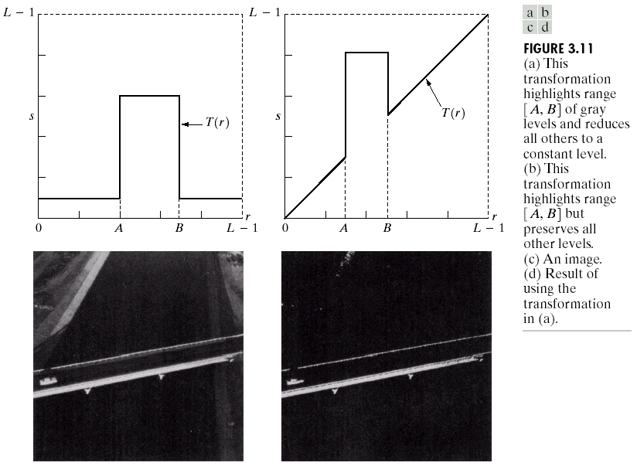
GRAY LEVEL SLICING
Gray Level Slicing → to highlight a specific range of grey levels
Similar → Thresholding
Other levels → suppressed or maintained
Useful → highlighting features in an image

Slide 3
Bit-Plane Slicing
by isolating particular bits of the pixel values in an image → highlight interesting aspects of that image
In an image
Higher-order bits usually contain most of the significant visual information
Lower-order bits contain subtle details

Slide 4
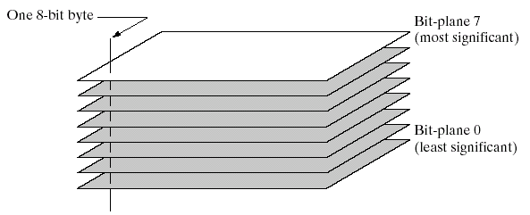
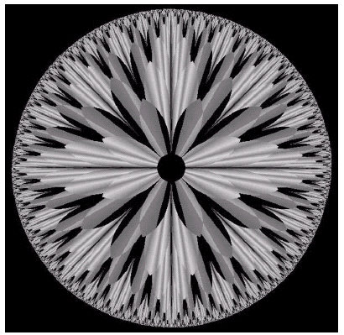
Bit-Plane Slicing

Slide 5
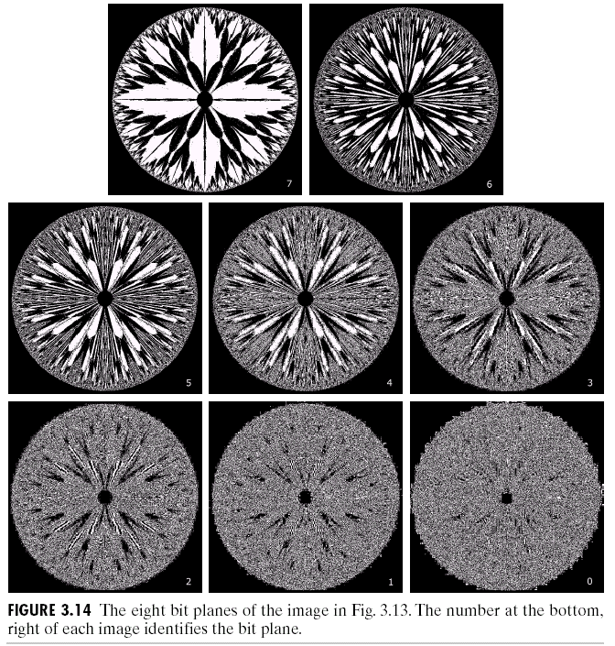
Bit-Plane Slicing
Bit-plane 7
1000 0000
Bit-plane 6
0100 0000
Bit-plane 5
0010 0000
Bit-plane 3
0000 1000
Original Image
Bit-plane 2
000 0100
Bit-plane 0
000 0001
Bit-plane 0
000 0010

Slide 6
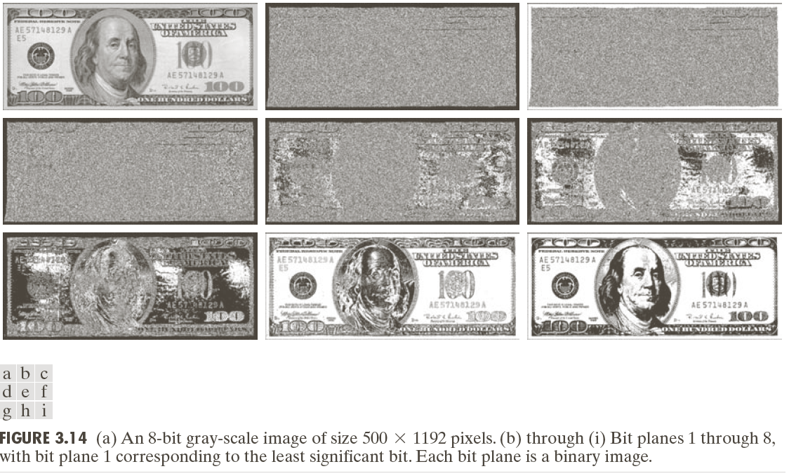
Bit-Plane Slicing

Slide 7
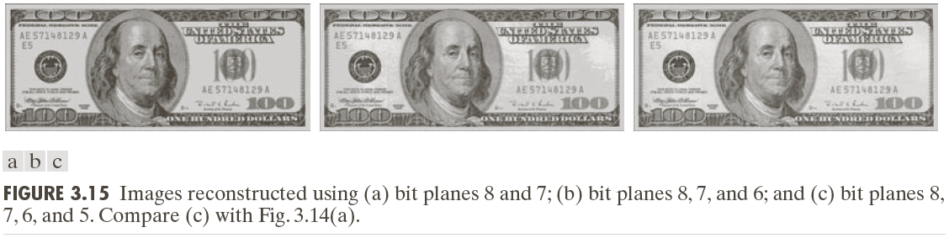
Bit-Plane Slicing
Reconstructed image using only bit planes 8 and 7
ORIGINAL IMAGE
Reconstructed image using only bit planes 8, 7 and 6
Reconstructed image using only bit planes 7, 6 and 5

Slide 8
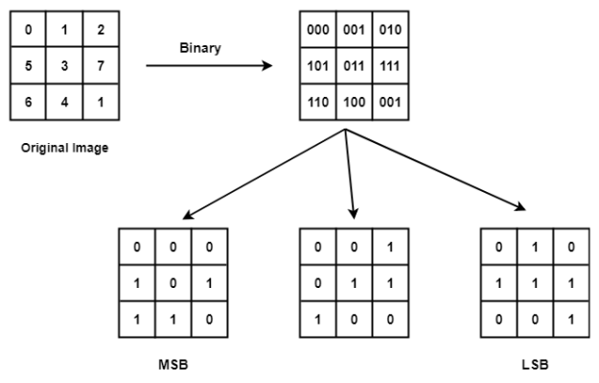
3-bit

Slide 9
Bit-Plane Slicing SUMMARY
In Bit-plane slicing, we divide the image into bit planes.
This is done by first converting the pixel values in the binary form and then dividing it into bit planes.
In general, images reconstructed from bit planes is similar to applying some intensity transformation function to the original image
ORIGINAL IMAGE

